Slide 1
Presentation title
HOTEL MANAGEMENT SYSTEM
Name
Date

Slide 2
Purpose, Scope, and Objectives:
The Hotel Management System is designed to streamline hotel operations, improve guest experiences, and manage bookings efficiently. It aims to bring automation and organization to all aspects of hotel management, including reservations, check-ins, billing, and more.

Slide 3
Project Description:
Our project involves creating a comprehensive Hotel Management System to cater to the needs of both hotel staff and guests. It is a digital solution that covers the entire spectrum of hotel management, offering a user-friendly interface for staff and an enhanced experience for guests.

Slide 4
Project Deliverables with Time Planning:
Initial Requirements Gathering (Weeks 1-2): Detailed requirements collection from hotel staff, managers, and potential guests.
Functional Requirements (Weeks 3-4): Compiling functional requirements, including reservation management, check-in/check-out, billing, room maintenance, and staff management.
OO System Design (Class Diagrams) (Weeks 5-6): Creating class diagrams to represent system structure and component relationships.
Development and Implementation (Weeks 7-10): Implementing the Hotel Management System based on the design.

Slide 5
Development Environment:
Tools and Techniques:
To create our class diagrams and facilitate object-oriented design, we will utilize industry-standard UML modeling tools, such as Lucidchart or draw.io. These tools offer comprehensive support for creating, visualizing, and sharing UML diagrams, ensuring the clarity and consistency of our design.

Slide 6
Requirement Collection for OO Design
For our Hotel Management System, we employed a systematic methodology to gather requirements effectively. This approach included:
Interviews: Engaging with hotel staff, managers, and potential guests to understand their specific needs and expectations.
Surveys: Conducting structured surveys to collect quantitative and qualitative data from a broader audience.
Observation: Actively observing hotel operations to identify key pain points and areas where automation can bring improvements.

Slide 7
Functional Requirements:
Reservation Management: Allowing guests to book rooms and manage reservations seamlessly.
Guest Check-In/Check-Out: Streamlining the check-in and check-out processes for a hassle-free guest experience.
Billing and Payment: Automating billing procedures and handling secure payment transactions.
Room Maintenance: Managing room availability and maintenance schedules.
Staff Management: Providing tools for staff to oversee guest services and operational tasks.

Slide 8
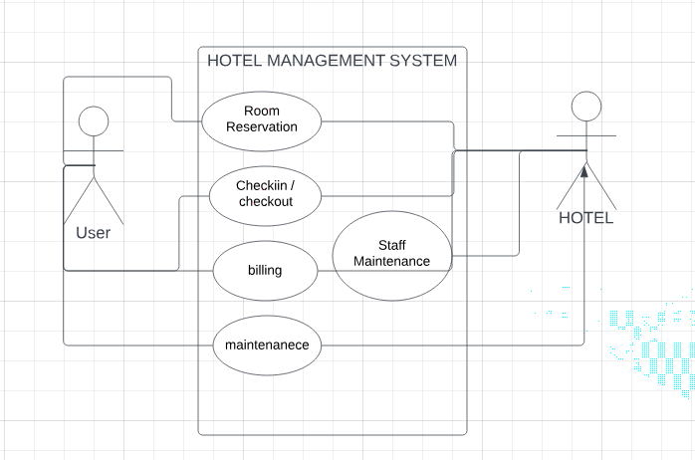
Use case Diagram

Slide 9
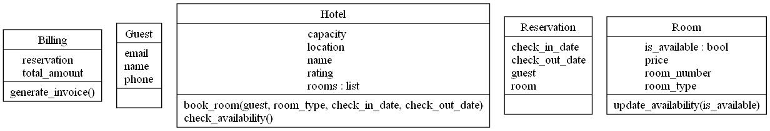
Class Diagram

Slide 10
Summary
The assignment centers on designing a Hotel Management System. It consists of two components: CW1 and CW2. CW1 covers system analysis and design, while CW2 extends to design patterns and implementation. This assignment assesses your object-oriented design and implementation skills, critical for module completion.

Slide 11
Thank you
Mirjam Nilsson​
mirjam@contoso.com
www.contoso.com

